Slide 1




University Institute of Engineering
Department of Computer Science & Engineering
COMPUTER ORGANIZATION & ARCHITECTURE
(23CST-204/23ITT-204)
ER. SHIKHA ATWAL
E11186
ASSISTANT PROFESSOR
BE-CSE

Slide 2
SYSTEM BUS
The basic computer has eight registers, a memory unit, and a control unit.
Paths must be provided to transfer information from one register to another and between memory and registers.
The number of wires will be excessive if connections are made between the outputs of each register and the inputs of the other registers.
A more efficient scheme for transferring information in a system with many registers is to use a common bus.
A bus is a set of wires. To send information from one component to other, the source component outputs data onto the bus and the destination component receives that data. As the complexity increases, it becomes more efficient to use buses rather than direct connection between pair of devices.
Bus uses space and power. They also require less pins on the chip.

Slide 3
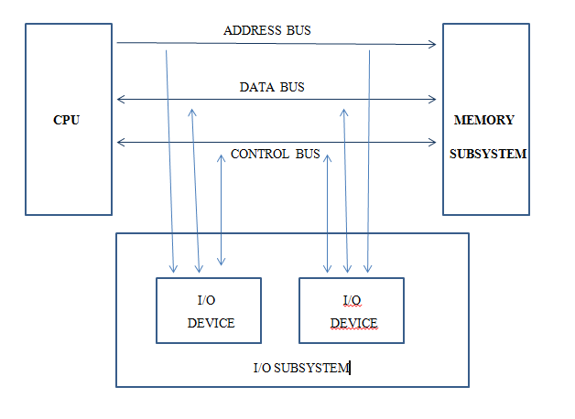
System Bus organization

Slide 4
Address Bus
When CPU reads data/instruction from or writes data to memory, it must specify the address of the new location it wishes to access.
CPU puts this address on the bus, memory takes the location as input and uses it to access that location.
All the components like keyboard, monitor or disk drive have a unique address as well. While accessing address of such devices, CPU places address of that particular device on the address bus. Each device reads the address placed on the address bus and the designated device comes to know that it is being accessed.

Slide 5
Address bus is unidirectional because of data flow in one direction, from the processor to memory or from the processor to input/out devices.
The length of the Address bus of 8085 microprocessor is 16-bit (That is, four hexadecimal digits), ranging from 0000H to FFFF H and 20-bit for 8086 microprocessor.
The microprocessor 8085 can transfer a maximum of 16-bit addresses which means it can address 65,536 different memory locations i.e. 64KB memory.

Slide 6
Data Bus
Data is transferred using data buses.
The data bus allows data to travel between the microprocessor (CPU) and memory (RAM).
Fetch: When CPU fetches data from memory, it first places the memory address on the address bus, the memory the outputs the data on the data bus which is then read by the CPU.
Write: CPU outputs the address on the address bus and then places data on the data bus. Memory, then reads data and stores that data at the memory location indicated by the address bus.
The data bus is bidirectional because of data flow in both directions, from the processor to memory or input/output devices and from memory or input/output devices to processors.
The length of the Data bus of 8085 microprocessor is 8 bit (that is, two hexadecimal Digits0, ranging from 00H to FFH and 16-bit for 8086 microprocessor.

Slide 7
Control Bus
Used by CPU for communicating with other devices within the computer.
Control bus carries the commands from the CPU and returns status signals from the devices.
Lines:
Read (R’) – single line that when active (at 0) indicates that device is being read by the CPU.
Write (W’) - single line that when active (at 0) indicates that device is being written by the CPU.
ACK: It delivers information that data was acknowledged by the device.
Bus request: Indicates that the device is requesting to access the bus.
Reset: reset the system.
Clock Signals: The signals on this line are used to synchronize data between the CPU and a device.

Slide 8
Control Bus is bidirectional.
The control bus carries the control signals to control all the associated peripherals, the microprocessor uses control bus to process data, that is what to do with selected memory location signals are memory card, memory write, input/output write

Slide 9
Common Bus System
Connections:
The outputs of all the registers except the OUTR (output register) are connected to the common bus. The output selected depends upon the binary value of variables S2, S1 and S0. The lines from common bus are connected to the inputs of the registers and memory. A register receives the information from the bus when its LD (load) input is activated while in case of memory the Write input must be enabled to receive the information. The contents of memory are placed onto the bus when its Read input is activated.

Slide 10
Various Registers:
4 registers DR, AC, IR and TR have 16 bits and 2 registers AR and PC have 12 bits. The INPR and OUTR have 8 bits each. The INPR receives character from input device and delivers it to the AC while the OUTR receives character from AC and transfers it to the output device. 5 registers have 3 control inputs LD (load), INR (increment) and CLR (clear). These types of registers are similar to a binary counter.

Slide 11
Abbreviation | Register name
OUTR | Output register
TR | Temporary register
IR | Instruction register
INPR | Input register
AC | Accumulator
DR | Data register
PC | Program counter
AR | Address register

Slide 12
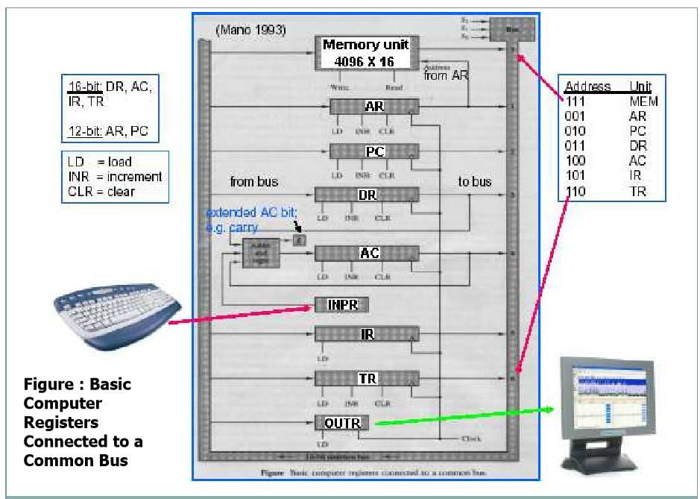
Basic Computer Registers Connected to Common Bus

Slide 13
Adder and logic circuit:
The adder and logic circuit provide the 16 inputs of AC. This circuit has 3 sets of inputs. One set comes from the outputs of AC which implements register micro-operations. The other set comes from the DR (data register) which are used to perform arithmetic and logic micro- operations. The result of these operations is sent to AC while the end around carry is stored in E as shown in diagram above. The third set of inputs is from INPR.
Note:
The content of any register can be placed on the common bus and an operation can be performed in the adder and logic circuit during the same clock cycle.

Slide 14
ADVANTAGES OF BUSES:
New elements can be easily added.
Low cost.
Reduce complexity.
DISADVANTAGES OF BUSES:
Creates a communication bottleneck.
Maximum speed is limited by
Length of the bus
Number of devices on the bus.

Slide 15
References
Reference Books:
J.P. Hayes, “Computer Architecture and Organization”, Third Edition.
Mano, M., “Computer System Architecture”, Third Edition, Prentice Hall.
Stallings, W., “Computer Organization and Architecture”, Eighth Edition, Pearson Education.
Text Books:
Carpinelli J.D,” Computer systems organization &Architecture”, Fourth Edition, Addison Wesley.
Patterson and Hennessy, “Computer Architecture” , Fifth Edition Morgaon Kauffman.
Video References:
https://www.youtube.com/watch?v=xBYhHC8_A6o
https://www.youtube.com/watch?v=qX_rqLO-tkU

